Slide 1
Database Systems Instructor: Syed Zishan Ali Department of Software Engineering The University of Lahore

Slide 2
Definitions
Database: organized collection of logically related data
Data: stored representations of meaningful objects and events
Structured: numbers, text, dates
Unstructured: images, video, documents
Information: data processed to increase knowledge in the person using the data
Metadata: data that describes the properties and context of user data

Slide 3
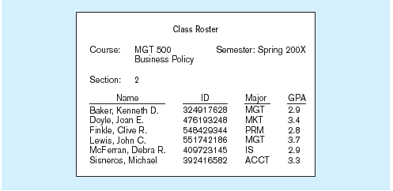
Data in context
Context helps users understand data

Slide 4
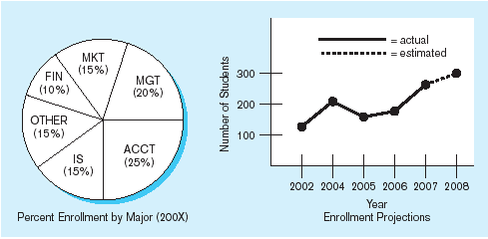
Summarized data
Graphical displays turn data into useful information that managers can use for decision making and interpretation

Slide 5
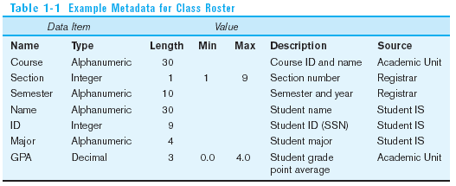
Descriptions of the properties or characteristics of the data, including data types, field sizes, allowable values, and data context

Slide 6
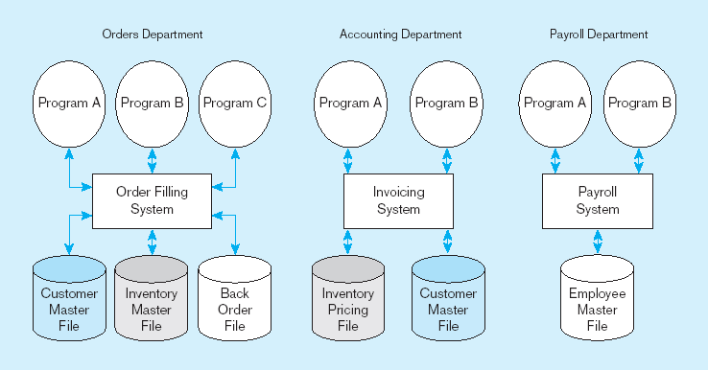
File Processing Systems

Slide 7
Disadvantages of File Processing
Program-Data Dependence
All programs maintain metadata for each file they use
Duplication of Data
Different systems/programs have separate copies of the same data
Limited Data Sharing
No centralized control of data
Lengthy Development Times
Programmers must design their own file formats
Excessive Program Maintenance
80% of information systems budget

Slide 8
Problems with Data Dependency
Each application programmer must maintain his/her own data
Each application program needs to include code for the metadata of each file
Each application program must have its own processing routines for reading, inserting, updating, and deleting data
Lack of coordination and central control
Non-standard file formats

Slide 9
Old file processing systems at Pine Valley Furniture Company
Duplicate Data

Slide 10
Problems with Data Redundancy
Waste of space to have duplicate data
Causes more maintenance headaches
The biggest problem:
Data changes in one file could cause inconsistencies
Compromises in data integrity

Slide 11
SOLUTION: The DATABASE Approach
Central repository of shared data
Data is managed by a controlling agent
Stored in a standardized, convenient form

Slide 12
Database Management System
A software system that is used to create, maintain, and provide controlled access to user databases
Order Filing
System
Central database
Contains employee,
order, inventory,
pricing, and
customer data
Invoicing
System
DBMS
Payroll
System
DBMS manages data resources like an operating system manages hardware resources

Slide 13
Advantages of the Database Approach
Program-data independence
Planned data redundancy
Improved data consistency
Improved data sharing
Increased application development productivity
Enforcement of standards
Improved data quality
Improved data accessibility and responsiveness
Reduced program maintenance
Improved decision support

Slide 14
Costs and Risks of the Database Approach
New, specialized personnel
Installation and management cost and complexity
Conversion costs
Need for explicit backup and recovery
Organizational conflict

Slide 15
The Range of Database Applications
Personal databases
Workgroup databases
Departmental/divisional databases
Enterprise database

Slide 16
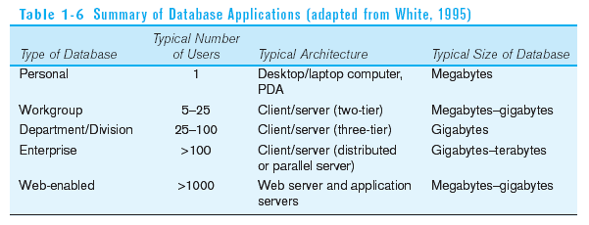

Slide 17
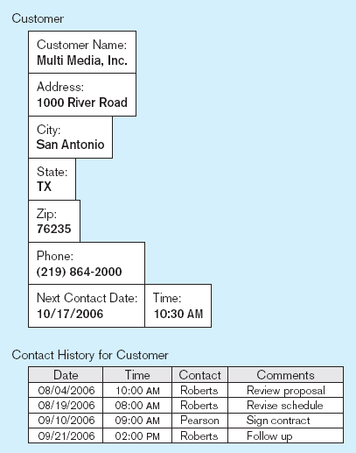
Typical data from a personal database

Slide 18
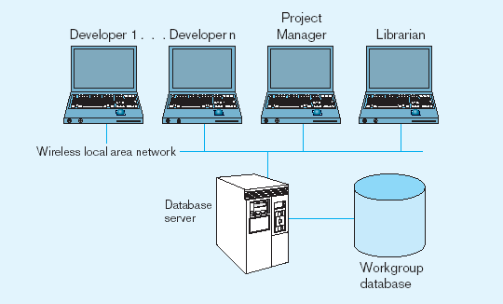
Workgroup database with wireless
local area network

Slide 19
Enterprise Database Applications
Enterprise Resource Planning (ERP)
Integrate all enterprise functions (manufacturing, finance, sales, marketing, inventory, accounting, human resources)
Data Warehouse
Integrated decision support system derived from various operational databases

Slide 20
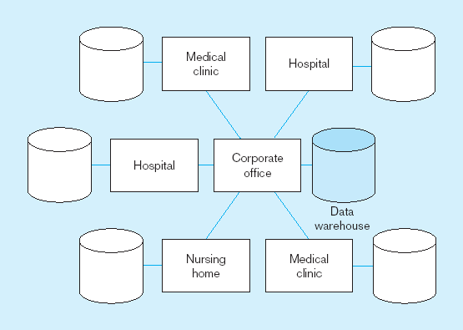
An enterprise data warehouse

Slide 21
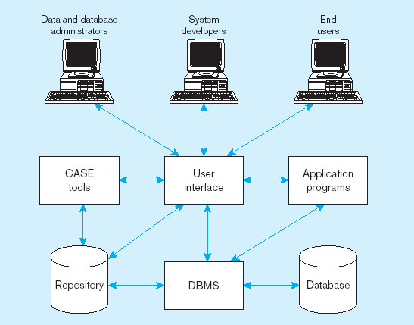
Components of the Database Environment

Slide 22
Components of the Database Environment
CASE Tools–computer-aided software engineering
Repository–centralized storehouse of metadata
Database Management System (DBMS) –software for managing the database
Database–storehouse of the data
Application Programs–software using the data
User Interface–text and graphical displays to users
Data/Database Administrators–personnel responsible for maintaining the database
System Developers–personnel responsible for designing databases and software
End Users–people who use the applications and databases

Slide 23
Elements of the Database Approach
Data models
Graphical system capturing nature and relationship of data
Enterprise Data Model–high-level entities and relationships for the organization
Relational Databases
Database technology involving tables (relations) representing entities and primary/foreign keys representing relationships
Use of Internet Technology
Networks and telecommunications, distributed databases, client-server, and 3-tier architectures
Database Applications
Application programs used to perform database activities (create, read, update, and delete) for database users

Slide 24
Enterprise Data Model
First step in database development
Specifies scope and general content
Overall picture of organizational data at high level of abstraction
Entity-relationship diagram
Descriptions of entity types
Relationships between entities
Business rules

Slide 25
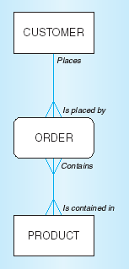
Segment from enterprise data model
Enterprise data model describes the high-level entities in an organization and the relationship between these entities

Slide 26
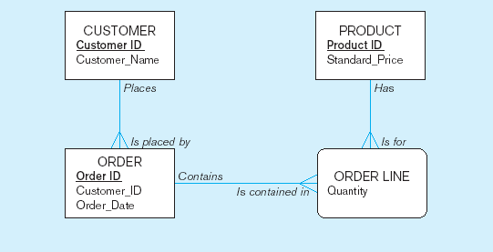
Segment of an Enterprise Data Model

Slide 27
One customer may place many orders, but each order is placed by a single customer
→ One-to-many relationship

Slide 28
One order has many order lines; each order line is associated with a single order
→ One-to-many relationship

Slide 29
One product can be in many order lines, each order line refers to a single product
→ One-to-many relationship

Slide 30
How Databases fit in to Organization Wide Information Systems

Slide 31
Information Systems Planning
Purpose–align information technology with organization’s business strategies
Three steps:
Identify strategic planning factors
Identify corporate planning objects
Develop enterprise model

Slide 32
Identify Strategic Planning Factors
Organization goals–what we hope to accomplish
Critical success factors–what MUST work in order for us to survive
Problem areas–weaknesses we now have

Slide 33
Identify Corporate Planning Objects
Organizational units–departments
Organizational locations
Business functions–groups of business processes
Entity types–the things we are trying to model for the database
Information systems–application programs

Slide 34
Develop Enterprise Model
Functional decomposition
Iterative process breaking system description into finer and finer detail
Enterprise data model

Slide 35
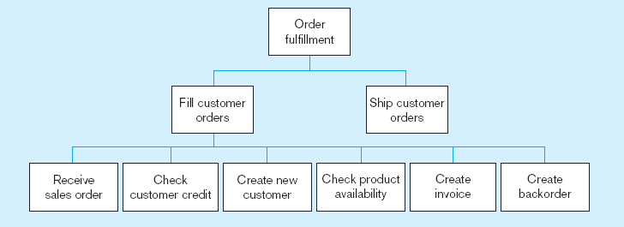
Example of process decomposition of an order fulfillment function (Pine Valley Furniture)
Decomposition = breaking large tasks into smaller tasks in a hierarchical structure chart

Slide 36
Two Approaches to Database and IS Development
SDLC
System Development Life Cycle
Detailed, well-planned development process
Time-consuming, but comprehensive
Long development cycle
Prototyping
Rapid application development (RAD)
Cursory attempt at conceptual data modeling
Define database during development of initial prototype
Repeat implementation and maintenance activities with new prototype versions

Slide 37
Systems Development Life Cycle
Planning
Analysis
Logical Design
Physical Design
Implementation
Maintenance

Slide 38
Systems Development Life Cycle (cont.)
Planning
Purpose–preliminary understanding
Deliverable–request for study
Planning
Analysis
Logical Design
Physical Design
Database activity–
enterprise modeling and early conceptual data modeling
Implementation
Maintenance

Slide 39
Systems Development Life Cycle (cont.)
Purpose–thorough requirements analysis and structuring
Deliverable–functional system specifications
Planning
Analysis
Analysis
Logical Design
Physical Design
Database activity–Thorough and integrated conceptual data modeling
Implementation
Maintenance

Slide 40
Systems Development Life Cycle (cont.)
Purpose–information requirements elicitation and structure
Deliverable–detailed design specifications
Planning
Analysis
Logical Design
Logical Design
Physical Design
Database activity–
logical database design (transactions, forms, displays, views, data integrity and security)
Implementation
Maintenance

Slide 41
Systems Development Life Cycle (cont.)
Purpose–develop technology and organizational specifications
Deliverable–program/data structures, technology purchases, organization redesigns
Planning
Analysis
Logical Design
Physical Design
Physical Design
Database activity–
physical database design (define database to DBMS, physical data organization, database processing programs)
Implementation
Maintenance

Slide 42
Systems Development Life Cycle (cont.)
Purpose–programming, testing, training, installation, documenting
Deliverable–operational programs, documentation, training materials
Planning
Analysis
Logical Design
Physical Design
Database activity–
database implementation, including coded programs, documentation, installation and conversion
Implementation
Implementation
Maintenance

Slide 43
Systems Development Life Cycle (cont.)
Planning
Purpose–monitor, repair, enhance
Deliverable–periodic audits
Analysis
Logical Design
Physical Design
Database activity–
database maintenance, performance analysis and tuning, error corrections
Implementation
Maintenance
Maintenance

Slide 44
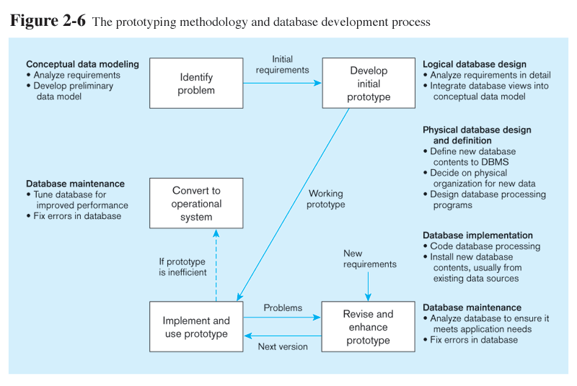
Prototyping Database Methodology

Slide 45
Prototyping Database Methodology (cont.)

Slide 46
Prototyping Database Methodology (cont.)

Slide 47
Prototyping Database Methodology (cont.)

Slide 48
Prototyping Database Methodology (cont.)

Slide 49
Managing Projects: People Involved
Business analysts
Systems analysts
Database analysts and data modelers
Users
Programmers
Database architects
Data administrators
Project managers
Other technical experts

Slide 50
Business Rules
Statements that define or constrain some aspect of the business
Assert business structure
Control/influence business behavior
Expressed in terms familiar to end users
Automated through DBMS software

Slide 51
A Good Business Rule is:
Declarative–what, not how
Precise–clear, agreed-upon meaning
Atomic–one statement
Consistent–internally and externally
Expressible–structured, natural language
Distinct–non-redundant
Business-oriented–understood by business people

Slide 52
A Good Data Name is:
Related to business, not technical, characteristics
Meaningful and self-documenting
Unique
Readable
Composed of words from an approved list

Slide 53
Data Definitions
Explanation of a term or fact
Term–word or phrase with specific meaning
Fact–association between two or more terms
Guidelines for good data definition
Gathered in conjunction with systems requirements
Accompanied by diagrams
Iteratively created and refined
Achieved by consensus

Slide 54
E-R Model Constructs
Entities:
Entity instance–person, place, object, event, concept (often corresponds to a row in a table)
Entity Type–collection of entities (often corresponds to a table)
Relationships:
Relationship instance–link between entities (corresponds to primary key-foreign key equivalencies in related tables)
Relationship type–category of relationship…link between entity types
Attribute–property or characteristic of an entity or relationship type (often corresponds to a field in a table)
Notes:
2

Slide 55
Sample E-R Diagram - 1
Pine valley furniture company can purchase items
from a number of different suppliers, who then ship
the items to the manufacturer. The items are
assembled into products that are sold to customers
who order the products. Each customer order may
include one or more lines corresponding to the
Products appearing on that order.
Notes:
2

Slide 56
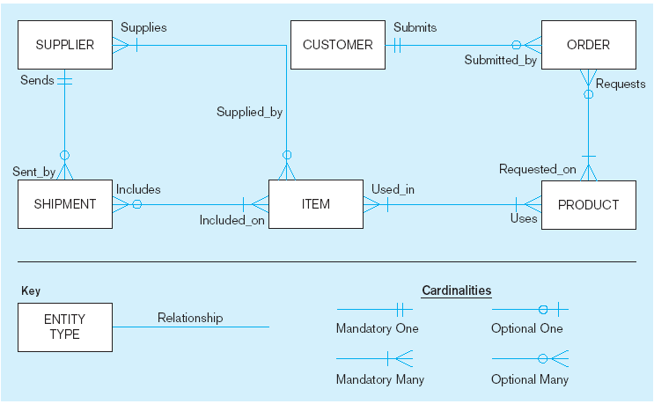
Sample E-R Diagram
A SUPPLIER may supply many ITEMs (by “may supply” we mean the supplier may not supply any items). Each ITEM is supplied by any number of SUPPLIERs (by “is supplied” we mean must be supplied by at least one supplier).
Each ITEM must be used in the assembly of at least one PRODUCT, and may be used in many products. Conversely, each PRODUCT must use one or more ITEMs.
A SUPPLIER may send many SHIPMENTs. On the other hand, each shipment must be sent by exactly one SUPPLIER.
A SHIPMENT must include one (or more) ITEMs. An ITEM may be included on several SHIPMENTs.
A CUSTOMER may submit any number of ORDERs. However, each ORDER must be submitted by exactly one CUSTOMER.
An ORDER must request one (or more) PRODUCTs. A given PRODUCT may not be requested on nay ORDER, or may be requested one one or more orders.
Notes:
3

Slide 57
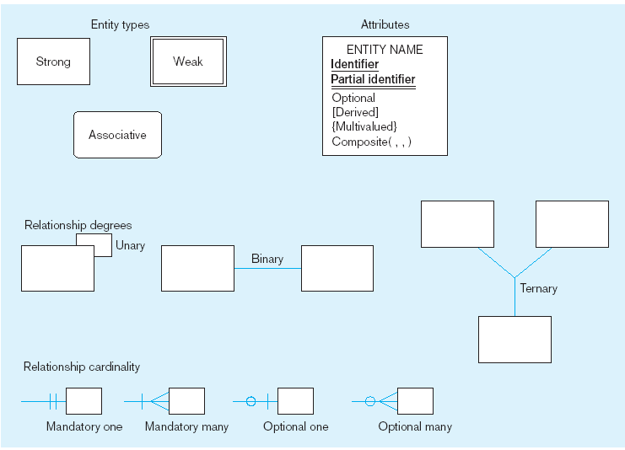
Basic E-R notation
Entity symbols
Attribute symbols
A special entity that is also a relationship
Relationship symbols
Relationship degrees specify number of entity types involved
Relationship cardinalities specify how many of each entity type is allowed
Notes:
8

Slide 58
What Should an Entity Be?
SHOULD BE:
An object that will have many instances in the database
An object that will be composed of multiple attributes
An object that we are trying to model
SHOULD NOT BE:
A user of the database system
An output of the database system (e.g., a report)

Slide 59
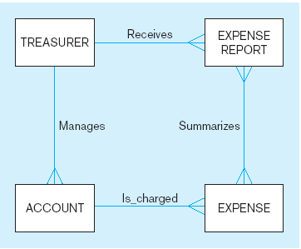
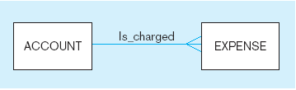
Example of inappropriate entities
System
user
System output
Inappropriate entities
Appropriate entities

Slide 60
Attributes
Attribute–property or characteristic of an entity or relationahip type
Classifications of attributes:
Required versus Optional Attributes
Simple versus Composite Attribute
Single-Valued versus Multivalued Attribute
Stored versus Derived Attributes
Identifier Attributes
Notes:
5

Slide 61
Identifiers (Keys)
Identifier (Key)–An attribute (or combination of attributes) that uniquely identifies individual instances of an entity type
Simple versus Composite Identifier
Candidate Identifier–an attribute that could be a key…satisfies the requirements for being an identifier
Notes:
6

Slide 62
Characteristics of Identifiers
Will not change in value
Will not be null
No intelligent identifiers (e.g., containing locations or people that might change)
Notes:
7

Slide 63
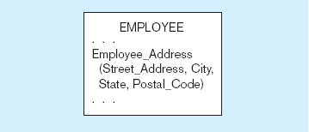
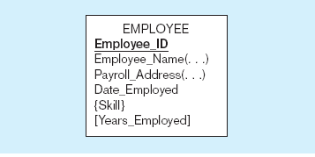
A composite attribute
An attribute broken into component parts
Entity with multivalued attribute (Skill)
and derived attribute (Years_Employed)
Multivalued
an employee can have
more than one skill
Derived
from date employed and current date
Notes:
12

Slide 64
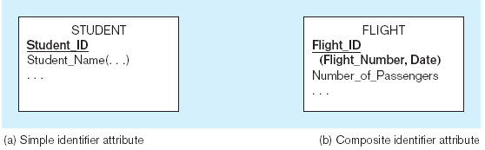
Simple and composite identifier attributes
The identifier is boldfaced and underlined
Notes:
14

Slide 65
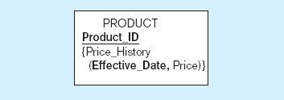
Simple example of time-stamping
This attribute that is both multivalued and composite
Notes:
37

Slide 66
Relationships
Examples of relationship types:
A branch is managed by at most one manager
A manager can manage at most one branch
A transaction can update one account
An account can be updated by many transactions
A customer can own many accounts
An account may be owned by more than one customer

Slide 67
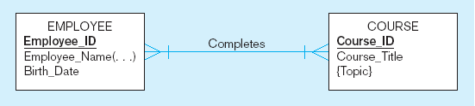
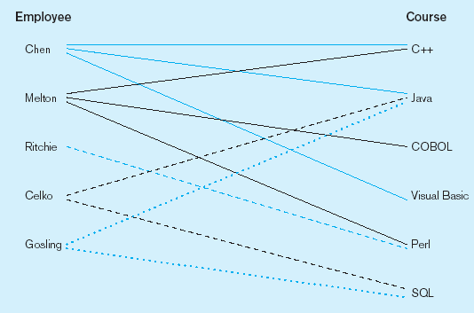
Relationship types and instances
a) Relationship type
b) Relationship instances
Notes:
17

Slide 68
Cardinality of Relationships
One-to-One
Each entity in the relationship will have exactly one related entity
One-to-Many
An entity on one side of the relationship can have many related entities, but an entity on the other side will have a maximum of one related entity
Many-to-Many
Entities on both sides of the relationship can have many related entities on the other side

Slide 69
Cardinality Constraints
Cardinality Constraints - the number of instances of one entity that can or must be associated with each instance of another entity
Minimum Cardinality
If zero, then optional
If one or more, then mandatory
Maximum Cardinality
The maximum number
Notes:
29

Slide 70
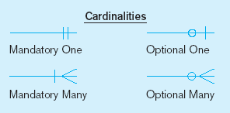
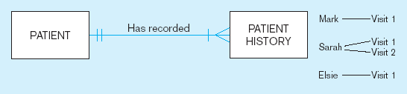
Examples of cardinality constraints
a) Mandatory cardinalities
A patient history is recorded for one and only one patient
A patient must have recorded at least one history, and can have many
Notes:
1

Slide 71
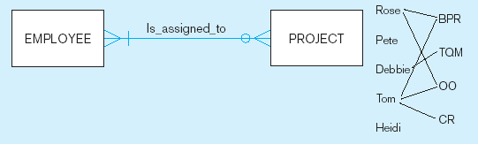
Examples of cardinality constraints (cont.)
b) One optional, one mandatory
A project must be assigned to at least one employee, and may be assigned to many
An employee can be assigned to any number of projects, or may not be assigned to any at all
Notes:
1

Slide 72
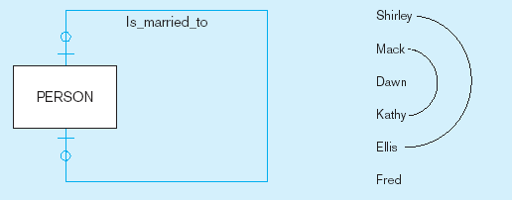
Examples of cardinality constraints (cont.)
a) Optional cardinalities
A person is is married to at most one other person, or may not be married at all
Notes:
1

Slide 73
Sample E-R Diagram – 2
ABC housing society is a medium sized local authority. One of the responsibilities of the
Society is the maintenance and repair of Society owned housing within its boundaries. The
authority wishes to develop an information system to monitor information on housing
repair work, a description of which is as follows:
“For the purpose of housing repair work, the society is divided into a number of areas.
Each area is subdivided into streets or roads, each street or road in likely to have a number
of houses along it. Details of each house are held, along with details of each instance of
repair work carried out to a specific house. Each area is maintained by a single repair team,
although a team may be responsible for more than one area. A repair team consists of a
number of employees, one of whom is designated the team supervisor. The team are
allocated a number of vehicles for use in their work, which are generally used by the
“owning” team only, although are occasionally “borrowed” by other Teams. Each team is
based at a maintenance depot, and in some cases, more than one team may be based at a
single depot”.
Notes:
2

Slide 74
Sample E-R Diagram - 2 (Entities Identified)
ABC housing society is a medium sized local authority. One of the responsibilities of the
Society is the maintenance and repair of Society owned housing within its boundaries. The
authority wishes to develop an information system to monitor information on housing
repair work, a description of which is as follows:
“For the purpose of housing repair work, the society is divided into a number of areas.
Each area is subdivided into streets or roads, each street or road in likely to have a
number of houses along it. Details of each house are held, along with details of each
instance of repair work carried out to a specific house. Each area is maintained by a
single repair team, although a team may be responsible for more than one area. A repair
team consists of a number of employees, one of whom is designated the team supervisor.
The team are allocated a number of vehicles for use in their work, which are generally
used by the “owning” team only, although are occasionally “borrowed” by other Teams.
Each team is based at a maintenance depot, and in some cases, more than one team may be
based at a single depot”.
Notes:
2

Slide 75
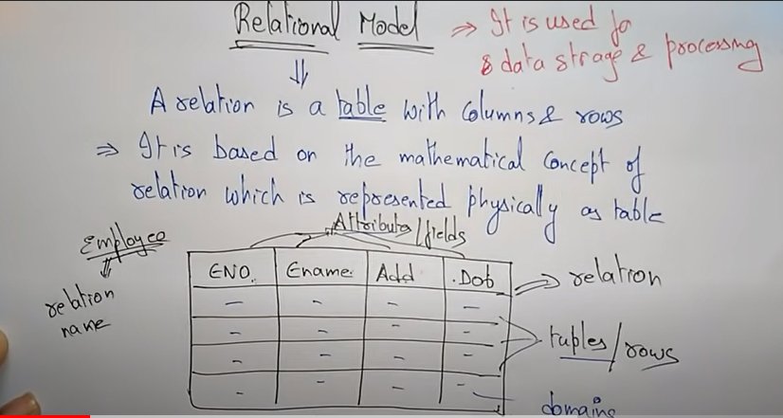
Relational Model

Slide 76
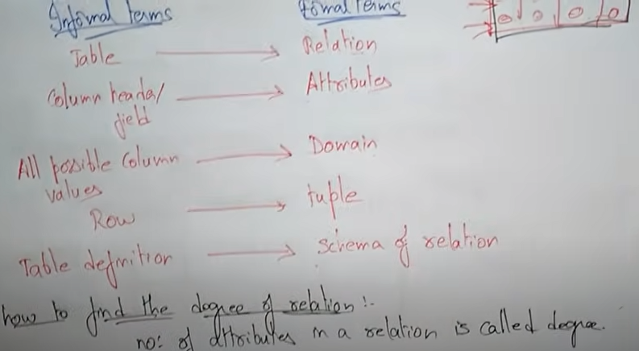
Relational Model

Slide 77
Relation
Definition: A relation is a named, two-dimensional table of data
Table consists of rows (records) and columns (attribute or field)
Number of attributes in a relation is called degree of relation
Number of tuples in a relation is called cardinality of relation.
Requirements for a table to qualify as a relation:
It must have a unique name
Every attribute value must be atomic (not multivalued, not composite)
Every row must be unique (can’t have two rows with exactly the same values for all their fields)
Attributes (columns) in tables must have unique names
The order of the columns must be irrelevant
The order of the rows must be irrelevant

Slide 78
Correspondence with E-R Model
Relations (tables) correspond with entity types and with many-to-many relationship types
Rows correspond with entity instances and with many-to-many relationship instances
Columns correspond with attributes
NOTE: The word relation (in relational database) is NOT the same as the word relationship (in E-R model)

Slide 79
Key Fields
Keys are special fields that serve two main purposes:
Primary keys are unique identifiers of the relation in question. Examples include employee numbers, social security numbers, etc. This is how we can guarantee that all rows are unique
Foreign keys are identifiers that enable a dependent relation (on the many side of a relationship) to refer to its parent relation (on the one side of the relationship)
Keys can be simple (a single field) or composite (more than one field)
Keys usually are used as indexes to speed up the response to user queries (Discussed Latter)

Slide 80
Key Fields
Super Key
If the attributes taking part in the construction of super key are sufficient but not necessary.
Candidate Key:
If all possible subsets of a super key is not a super key then that key is called a candidate key. It is also called a minimal super key.
Attributes are sufficient as well as mandatory.
Primary key
Implemented candidate key is called Primary key.
Alternate Key
During design. if one of candidate key has made primary key then the leftover candidate keys may also called alternate keys.

Slide 81
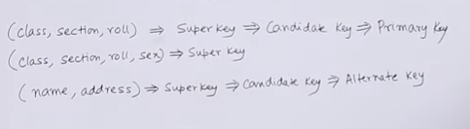
Key Fields

